Slide 1
Java--Inheritance

Slide 2
Agenda
Inheritance
Classification of inheritance
Constructors in inheritance
Using super
Method overriding
Type casting of reference types
Abstract class
final keyword
Object class

Slide 3
Inheritance
Implements IS-A relationship
Capability of a class to use the properties & methods of another class while adding its own functionality
A class derived from another class is called as subclass / derived class / extended class / child class
The class from which the subclass is derived is called as superclass / base class / parent class
Each class is allowed to have one direct superclass
Each superclass can have unlimited number of subclasses

Slide 4
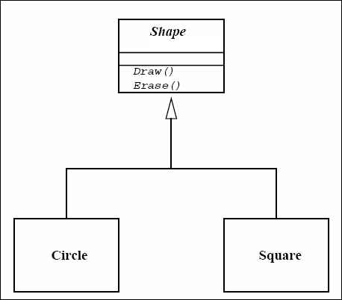
Inheritance (Contd…)
Super Class
Sub Class
Sub Class

Slide 5
Inheritance (Contd…)
A class is declared subclass of another class by using the extends keyword
All base class fields & methods are inherited by the subclass
private members of the super class are not accessible directly by any method of the subclass
static data members of the base class are also inherited
protected members of the super class are inherited by subclass
class SubClass extends BaseClass{
…
}

Slide 6
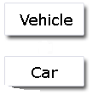
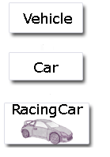
Types of Inheritance
Java supports two types of inheritance
Single Inheritance Multilevel Inheritance
Note: Java doesn’t support Multiple Inheritance (One sub class deriving from more than one super classes)

Slide 7
Inheritance Classification
Single Inheritance
Hierarchical Inheritance
Multi Level Inheritance
Hybrid Inheritance
Multiple Inheritance

Slide 8
Inheritance Classification

Slide 9
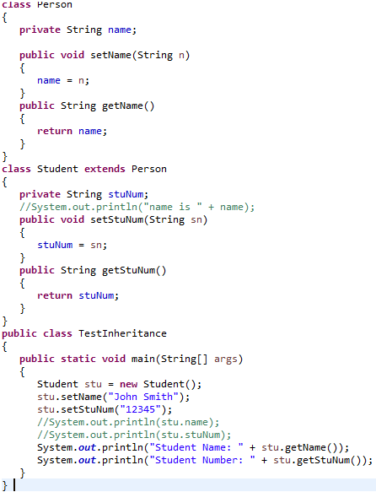
Inheritance
Student Name: John Smith
Student Number: 12345

Slide 10
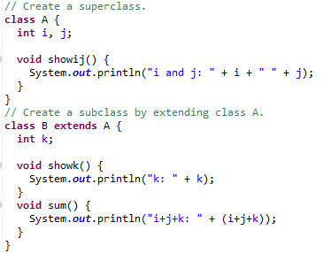
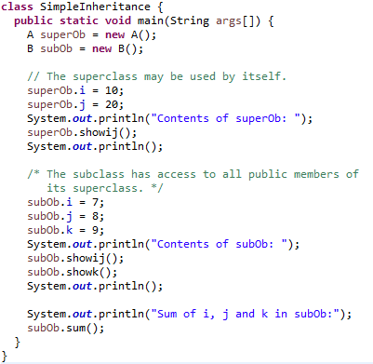
Inheritance
Contents of superOb:
i and j: 10 20
Contents of subOb:
i and j: 7 8
k: 9
Sum of i, j and k in subOb:
i+j+k: 24

Slide 11
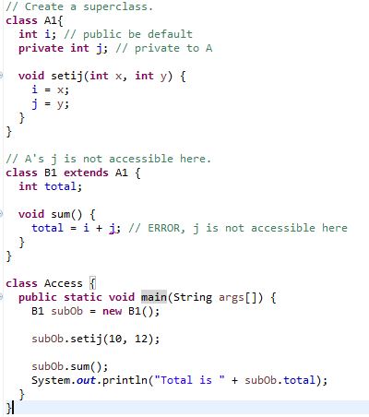

Member access and Inheritance
Although a subclass includes all of the members of its superclass, it cannot access those members of the superclass that have been declared as private.

Slide 12
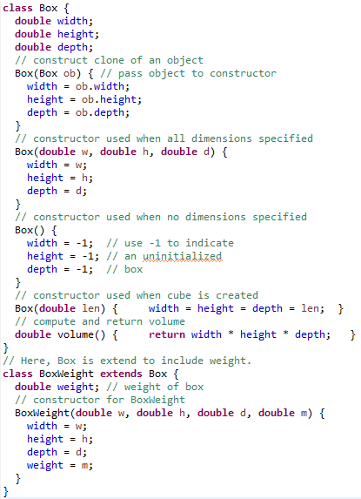
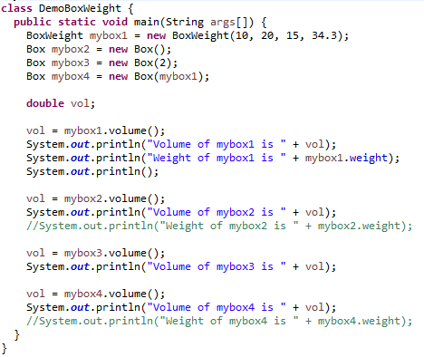
Volume of mybox1 is 3000.0
Weight of mybox1 is 34.3
Volume of mybox2 is -1.0
Volume of mybox3 is 8.0
Volume of mybox4 is 3000.0

Slide 13
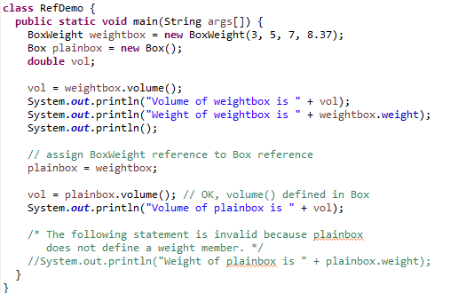
A Superclass Variable Can Reference a Subclass Object
A reference variable of a superclass can be assigned a reference to any subclass derived from that superclass.
Volume of weightbox is 105.0
Weight of weightbox is 8.37
Volume of plainbox is 105.0

Slide 14
Constructors in Inheritance
Constructors are invoked in the order of hierarchy
While instantiating a sub class, its super class default constructor will be invoked first, followed by the sub class constructor
The keyword super can be used to invoke the super class parameterized constructor instead of the default
Remember that:
super() call must occur as the first statement in constructor
super() call can only be used in a constructor definition
Refer DemoSuper.java

Slide 15
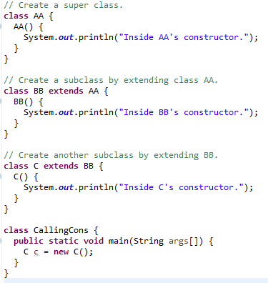
When constructors are called
Inside AA's constructor.
Inside BB's constructor.
Inside C's constructor.

Slide 16
Using super
(i) The first use of keyword super is to access the hidden data variables of the super class hidden by the sub class.
e.g. Suppose class A is the super class that has two instance variables as int a and float b. class B is the subclass that also contains its own data members named a and b. then we can access the super class (class A) variables a and b inside the subclass class B just by calling the following command.
super.member;
Here member can either be an instance variable or a method. This form of super most useful to handle situations where the local members of a subclass hides the members of a super class having the same name.
(ii) Use of super to call super class constructor: The second use of the keyword super in java is to call super class constructor in the subclass.
super(param-list);
Here parameter list is the list of the parameter requires by the constructor in the super class. super must be the first statement executed inside a super class constructor. If we want to call the default constructor then we pass the empty parameter list.
(iii) Used when we need to call a method that is overridden in this base class in order to specify that the method should be called on the superclass.
super.method_name();

Slide 17
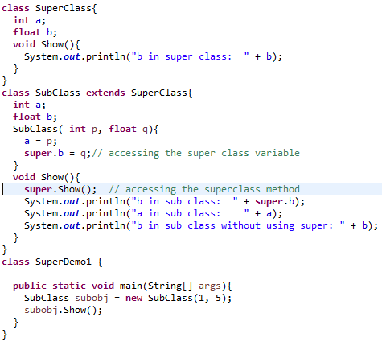
Using super
b in super class: 5.0
b in sub class: 5.0
a in sub class: 1
b in sub class without using super: 0.0

Slide 18
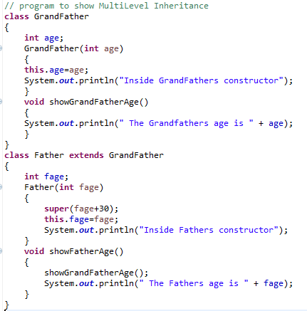
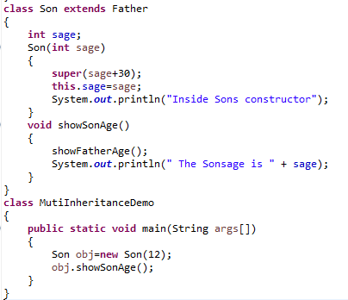
Using super and Multi Inheritance
Inside GrandFathers constructor
Inside Fathers constructor
Inside Sons constructor
The Grandfathers age is 72
The Fathers age is 42
The Sonsage is 12

Slide 19
What is not possible using java class Inheritance?
1. Private members of the superclass are not inherited by the subclass and can only be indirectly accessed.
2. Members that have default accessibility in the superclass are also not inherited by subclasses in other packages, as these members are only accessible by their simple names in subclasses within the same package as the superclass.
3. Since constructors and initializer blocks are not members of a class, they are not inherited by a subclass.
4. A subclass can extend only one superclass

Slide 20
Method Overriding
In a class hierarchy, when a method in a subclass has the same name and type signature as a method in its superclass, then the method in the subclass is said to override the method in the superclass.
When an overridden method is called from within a subclass, it will always refer to the version of that method defined by the subclass.
The version of the method defined by the superclass will be hidden.
A subclass can override a method defined in its superclass by providing a new implementation for that method.
Method overriding occurs only when the names and the type signatures of the two methods are identical. If they are not, then the two methods are simply overloaded.

Slide 21
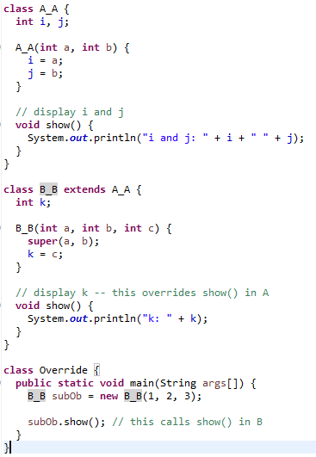
Method Overriding

Slide 22
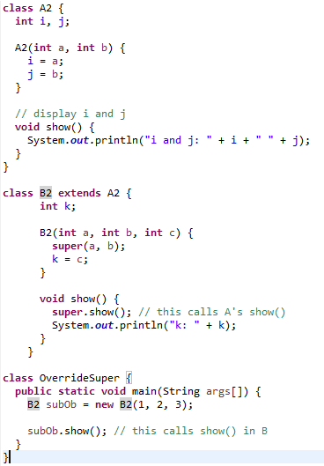
Method Overriding
If you wish to access the superclass version of an overridden method, you can do so by using super.
Here, super.show( ) calls the superclass version of show( ).

Slide 23
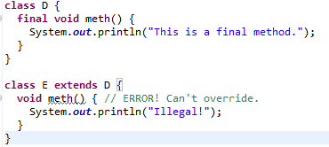
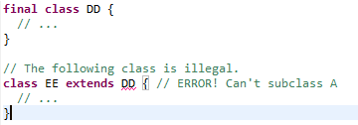
final methods and classes

Slide 24
final keyword
A java variable can be declared using the keyword final. Then the final variable can be assigned only once.
A variable that is declared as final and not initialized is called a blank final variable. A blank final variable forces the constructors to initialize it.
Java classes declared as final cannot be extended. Restricting inheritance!
Methods declared as final cannot be overridden. In methods private is equal to final, but in variables it is not.
final parameters – values of the parameters cannot be changed after initialization.

Slide 25
Type casting of reference types
We can assign a variable of a certain class type with an instance of that particular class or an instance of any subclass of that class
When we cast a reference along the class hierarchy in a direction from the root class towards the subclasses, it’s a downcast
When we cast a reference along the class hierarchy in a direction from the sub classes towards the root, it’s an upcast
public class Mammal { .. . . . }
public class Dog extends Mammal { . . . . }
Mammal m=new Mammal();
Dog d=(Dog) m; // explicit casting
Mammal m=new Dog();// implicit casting

Slide 26
Binding
Happens when a method invocation is bound to an implementation
Involves lookup of the method in the class, or one of its parents
Both method names & parameters are checked
Can happen at :
Compilation Time (Static Binding)
Execution Time (Dynamic Binding)

Slide 27
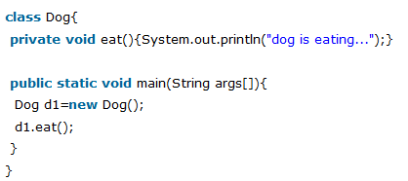
Static binding or Early binding
When type of the object is determined at compiled time(by the compiler), it is known as static binding.
If there is any private, final or static method in a class, there is static binding.

Slide 28
Dynamic binding or Late binding
Dynamic Binding refers to the case where compiler is not able to resolve the call and the binding is done at runtime only.
Suppose we have a class named 'SuperClass' and another class named 'SubClass' extends it.
Now a 'SuperClass' reference can be assigned to an object of the type 'SubClass' as well.
If we have a method (say 'someMethod()') in the 'SuperClass' which we override in the 'SubClass' then a call of that method on a 'SuperClass' reference can only be resolved at runtime as the compiler can't be sure of what type of object this reference would be pointing to at runtime.

Slide 29
Dynamic binding or Late binding (Dynamic method dispatch)
Even though both the object references superClass1 and superClass2 are of type 'SuperClass' only, but at run time they refer to the objects of types 'SuperClass' and 'SubClass' respectively.
Hence, at compile time the compiler can't be sure if the call to the method 'someMethod()' on these references actually refer to which version of the method - the super class version or the sub class version.
Thus, we see that dynamic binding in Java simply binds the method calls (inherited methods only as they can be overriden in a sub class and hence compiler may not be sure of which version of the method to call) based on the actual object type and not on the declared type of the object reference.
... SuperClass superClass1 = new SuperClass(); SuperClass superClass2 = new SubClass(); ... superClass1.someMethod(); // SuperClass version is called superClass2.someMethod(); // SubClass version is called ....

Slide 30
Some Questions
Can we overload static methods?
Can we overload methods that differ only by static keyword?
Can we Override static methods in java?

Slide 31
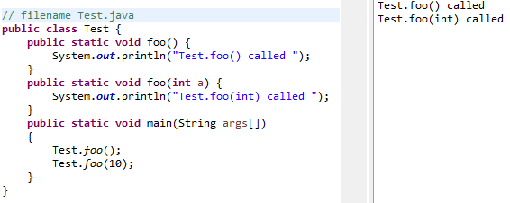
Can we overload static methods?

Slide 32
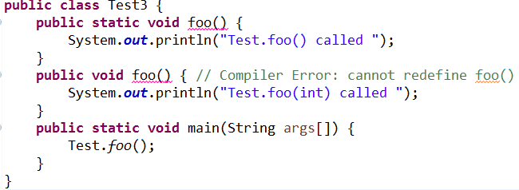

Can we overload methods that differ only by static keyword?

Slide 33
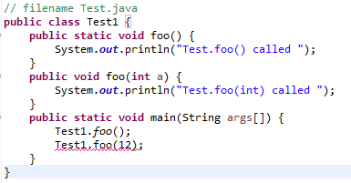

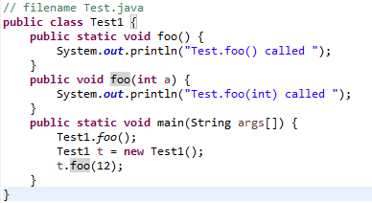

Can we overload methods that differ only by static keyword?

Slide 34
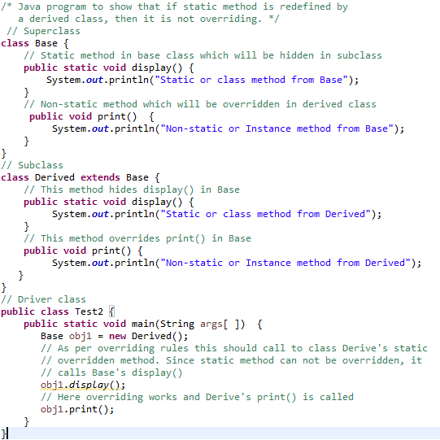

Can we Override static methods in java?

Slide 35
Method overriding and static methods
No, you cannot override static method in Java because method overriding is based upon dynamic binding at runtime and static methods are bonded using static binding at compile time.
Though you can declare a method with same name and method signature in sub class which does look like you can override static method in Java but in reality that is method hiding.
Java won't resolve method call at runtime and depending upon type of Object which is used to call static method, corresponding method will be called.
It means if you use Parent class's type to call static method, original static will be called from parent class, on the other hand if you use Child class's type to call static method, method from child class will be called.
In short you can not override static method in Java.

Slide 36
Some points to remember
For instance (or non-static) methods, the method is called according to the type of object being referred, not according to the type of reference, which means method calls is decided at run time.
For class (or static) methods, the method according to the type of reference is called, not according to the abject being referred, which means method call is decided at compile time.
An instance method cannot override a static method, and a static method cannot hide an instance method.
The distinction between hiding a static method and overriding an instance method has important implications:
The version of the overridden instance method that gets invoked is the one in the subclass.
The version of the hidden static method that gets invoked depends on whether it is invoked from the superclass or the subclass.

Slide 37
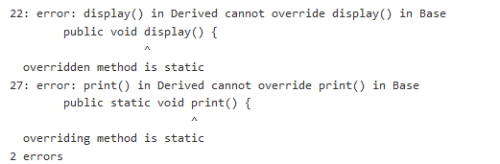
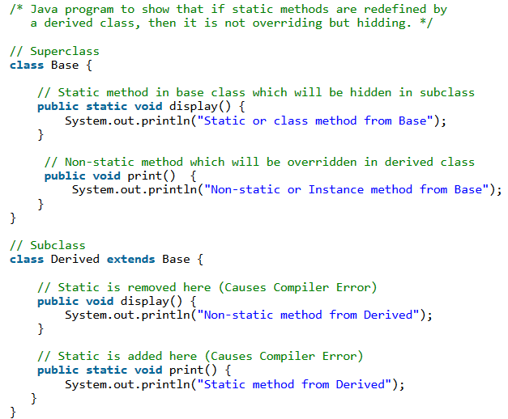

Slide 38
Abstract Methods
Sometimes it is required that a superclass that declares the structure of a given abstraction without providing a complete implementation of every method
Create a superclass that only defines a generalized form that will be shared by all of its subclasses, leaving it to each subclass to fill in the details
This situation can occur is when a superclass is unable to create a meaningful implementation for a method.
It is not uncommon for a method to have no meaningful definition in the context of its superclass
Want some way to ensure that a subclass does, indeed, override all necessary methods. Define a method as abstract
abstract methods are sometimes referred to as subclasserresponsibility because they have no implementation specified in the superclass. Thus, a subclass must override them—it cannot simply use the version defined in the superclass.
To declare an abstract method, use this general form:
abstract type name(parameter-list);

Slide 39
Abstract Classes
Any class that contain one or more abstract method must also be declared as abstract
There can be no objects of an abstract class
Such objects would be useless, because an abstract class is not fully defined
Also, you cannot declare abstract constructors, or abstract static methods
Any subclass of an abstract class must either implement all of the abstract methods in the superclass, or be itself declared abstract

Slide 40
Abstract Class
abstract class Shape
{
public abstract void draw();
}
Concrete class
A class can extend only one class
class Circle extends Shape
{
public void draw()
{
-------
}
}

Slide 41
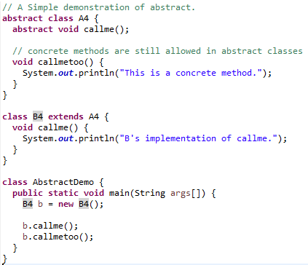

Abstract Class

Slide 42
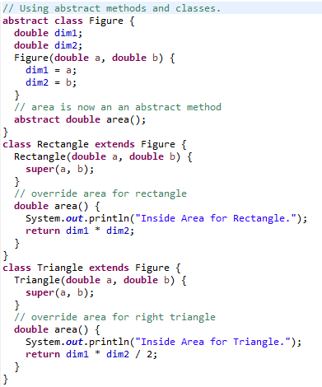
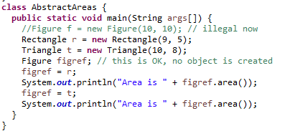
Abstract Class
Inside Area for Rectangle.
Area is 45.0
Inside Area for Triangle.
Area is 40.0

Slide 43
The Object Class
Object is the base class for all Java classes
Every class extends this class directly or indirectly
Present in the package java.lang which is imported by default into all java programs
Object
A
class A
{
…
}
public class B extends A
{
…
}
B
9/19/2017
CONFIDENTIAL© Copyright 2008 Tech Mahindra Limited
43
Notes:
43

Slide 44
Methods of Object Class
Refer to ObjectDemo.java
toString() | Returns a string representation of the object
finalize() | Called by the garbage collector on an object when there are no more references to the object
equals() | Indicates if some other object is "equal to" this one
clone() | Creates and returns a copy of this object. The precise meaning of "copy" may depend on the class of the object
hashCode() | Returns a hash code value for the object. This method is supported for the benefit of hashtables such as those provided by java.util.Hashtable
9/19/2017
CONFIDENTIAL© Copyright 2008 Tech Mahindra Limited
44
Notes:
44

Slide 45
THANK YOU!!
ANY QUESTIONS??

